Slide 1
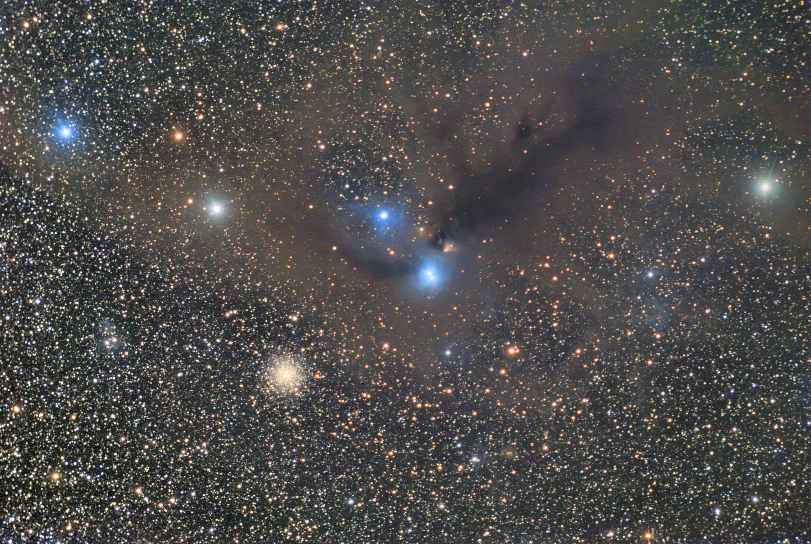
Mapping the Full Extent of Dust in Molecular Clouds
Jaquelin Erazo
CUNY Hunter College
Prof. Tim Paglione – CUNY York College
Credit: IceinSpace
Notes:
Hello my name is Jaquelin Erazo and I am a junior in physics at Hunter College. For the past year and a half, I worked with Prof. Tim Paglione on mapping the full-extent of dust in molecular clouds. There is a great importance in studying molecular clouds, which are made of dust and gas, since they are vital to the birth of stars and planets. However, it is difficult to study and observe them directly due to large systematic errors. Instead, we study them indirectly via the dust extincted stars behind the cloud.

Slide 2
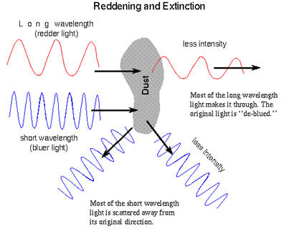
Extinction
Wavelength dependent
Shorter wavelengths preferentially scattered
Infrared bands for dense areas
High extinction
Optical bands for thin areas
Low extinction
Credit: Astronomy Notes
Notes:
When a dust cloud is between an observer and a star, it not only scatters and dims starlight, but it also reddens it. This effect is known as extinction. Extinction is wavelength dependent where shorter wavelength are more preferentially scattered. Therefore, infrared bands, or long wavelength colors, are used because we are able to “look through” the dense areas of dust clouds and detect stars despite the extinction. On the other hand, infrared studies are only able to probe relatively high extinctions. In order to measure very low extinction regions, shorter wavelengths, or optical bands, are preferred.

Slide 3
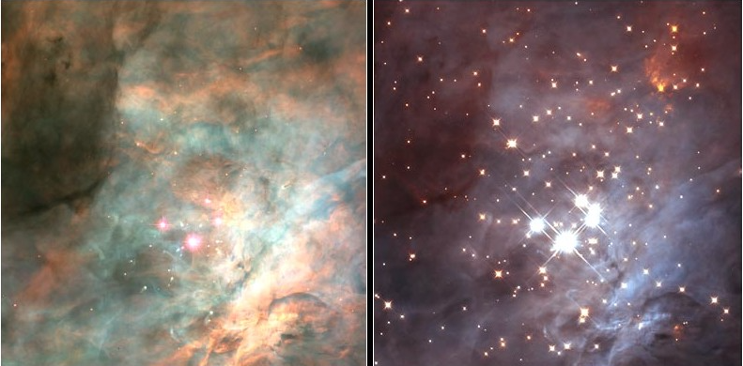
Extinction
Optical
Infrared
Credit: Hubble Space Telescope
Notes:
Shown here are two different pictures of Orion. On the left is an optical image and on the right is an infrared image. You can clearly see the dust cloud in the optical image of Orion, although you lose stars in the process, especially in the thick and dense areas of the cloud. In the infrared image, we are able to look through the cloud and see the stars behind it, including stars we cannot see at all in the optical image, but we lose the structure of the cloud itself.

Slide 4
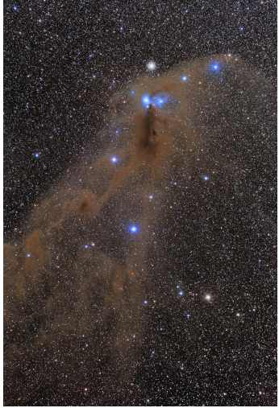
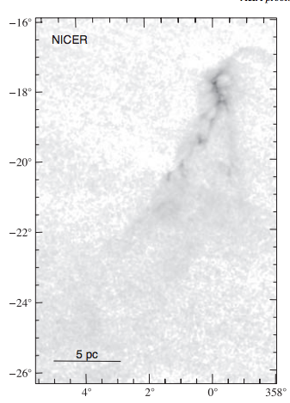
Near-Infrared Color Excess Methods
Optical
Near-Infrared
Alves et al. 2014
J. Alves, M. Lombardi and C. Lada. “2MASS wide-field extinction maps: V. Corona Australis”. A&A. July 2001.
Notes:
There are methods to map a molecular cloud via extinction such as NICE (yes that is the actual name), which stands for Near-Infrared Color Excess. Its procedure contains comparing individual extincted stars to a model star. The color excess is essentially the reddening occurring. However, NICE presents large systematic errors. NICER - Near-Infrared Color Excess Revisted - focuses on NICE’s limitations, and makes NICE nicer. NICER accounts for the intrinsic color scatter and the photometric errors. Shown here is an optical image of V. Corona Australis and an extinction map of Corona Australis in the near-infrared. The head of the cloud, or the dense portion, is clearly displayed on the extinction map, but we begin to lose the structure of the thin areas as we go further down. And in the optical image, once again you see the whole structure of the cloud, but begin to lose the stars in the dense areas. What makes my project different from these methods is that I will include both optical and near-infrared bands into my research in order to not only study the dense portions of a cloud, but the thin portions as well.
This is the main reason why we chose the nearby cloud R Corona Australis to test our method because it contains both dense and “wispy” areas. The extinction in this cloud has also been mapped before by Alves et al. (2014) so we may compare our results to theirs. It also has a lot of background stars since it is low enough in galactic latitude, yet is still relatively isolated.

Slide 5

Finding Catalogues/Data
Catalogue with B, V, R, J, H and K data
NOMAD: Naval Observatory Merged Astrometric Dataset (Hipparcos, Tycho-2, and USNO-B1 catalogues and 2MASS photometry)³
Credit: USNO
Notes:
I utilized the data from NOMAD (Naval Observatory Merged Astrometric Dataset) since it contains data in both the optical and the near-infrared bands labeled as B, R, J, H, and K. These are broad filter bands centered in the blue, red, and three near-infrared regions up to 2.2 microns. NOMAD contains multiple catalogues, such as 2MASS photometry and the Digital Sky Survey. 2MASS scans the entire sky with three near-infrared bands and DSS is a multi- filter imaging and spectroscopic redshift survey.

Slide 6
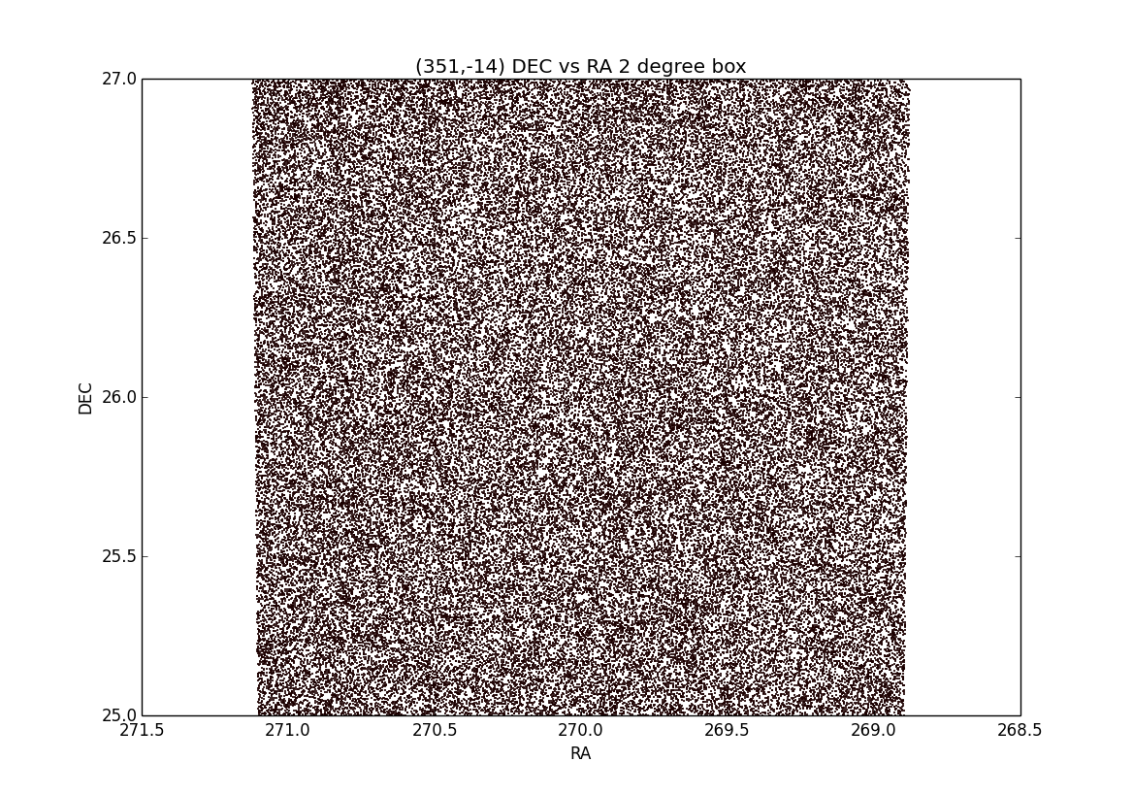
Control Field
No cloud = No extinction!
Notes:
I have mentioned the word “control field” and this is what it looks like. My area has the coordinates of (354, -14), the same used from Alves et al. and there is no dust cloud present, meaning there is no extinction. This area is my non-extincted area and I use this to compare extincted areas and find how much extinction there is quantitatively.

Slide 7
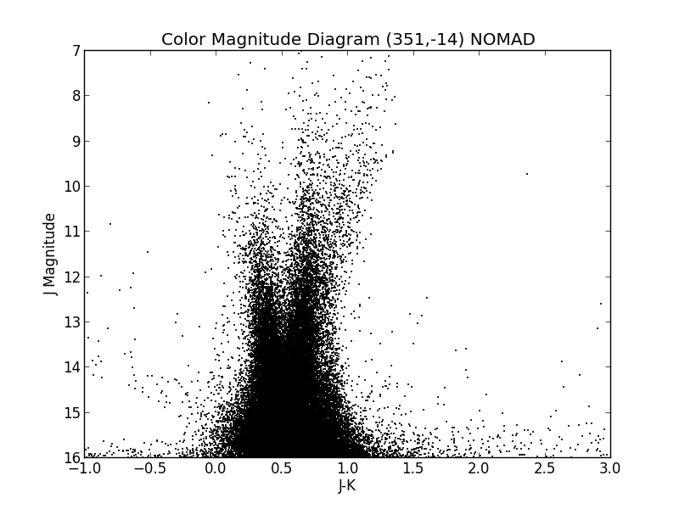
CMDs & CCDs
Brighter
Red Giants
Main Sequence
Fainter/Farther
Blue/Hot
Red/Cool
Notes:
I began my project creating a Color Magnitude Diagram, or an H-R Diagram. On the x-axis is a color, or two bands subtracted, and on the y-axis is a band. The field I have chosen is my control field. The further to your left, the redder and cooler the star, and the further to your right, the bluer and hotter the star. Further down, the fainter, or farther, the star and the higher up, the brighter the star. You can clearly see the main sequence for this field as well as the Red Giants branch. The smear on the bottom plots the stars that are either far away or not luminous stars.

Slide 8
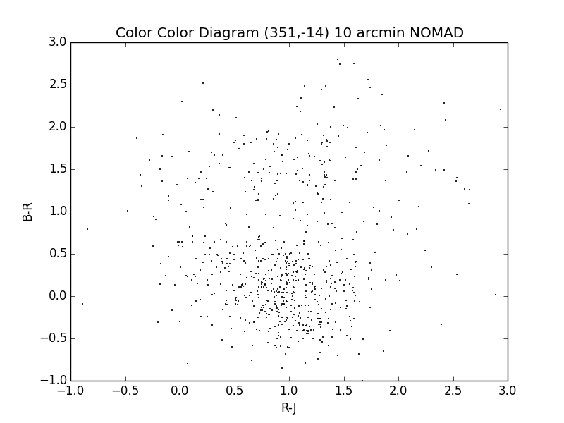
CMDs & CCDs
Red/Cool
Reddening
Blue/Hot
Blue/Hot
Red/Cool
Notes:
In a Color-Color Diagram, both axis contain colors, and it focuses on the intrinsic color of the stars and not on their distance. We are also able to see the direction of reddening, which is directed further right and up.

Slide 9
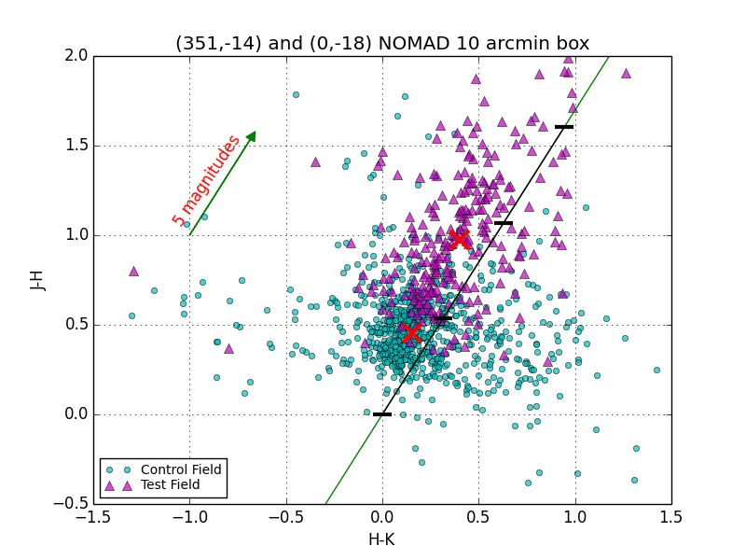
Quantifying Extinction
Near-Infrared
Rieke & Lebofsky ‘85
Notes:
In order to quantify the extinction, I compare a test field, or a field with extinction, to a control field, or a field without extinction. Shown here in pink triangles is the test field, which is an area in R Corona Australis, and in blue circles the control field, which I mentioned previously. Then taking the median of both fields, represented by the red x, you can clearly see the offset indicating the extinction. The slope represents the reddening curve and the ticks have a spacing of 5 magnitudes. As you can see in this Color-Color Diagram of J-H versus H-K, the offset of the medians, or the extinction, is approximately 5 magnitudes. Now as we go further into the optical, you would think that the extinction would increase. . In fact, the opposite begins to happen.

Slide 10
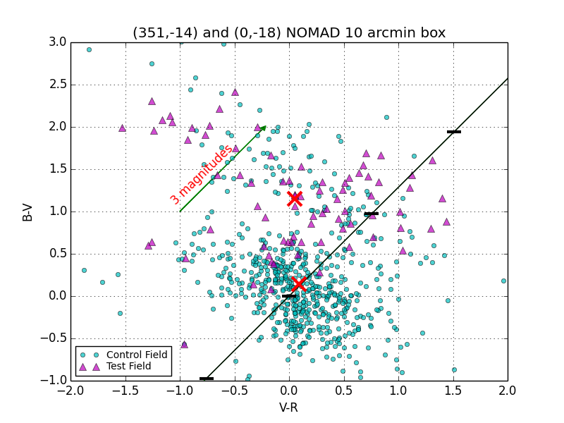
Quantifying Extinction
Optical
Notes:
Once again, the pink triangles is the test field and the blue circles is the control field, and the tick marks on the reddening curve are spaced 3 magnitudes. Not only does the extinction decrease, but there are less stars being plotted.

Slide 11
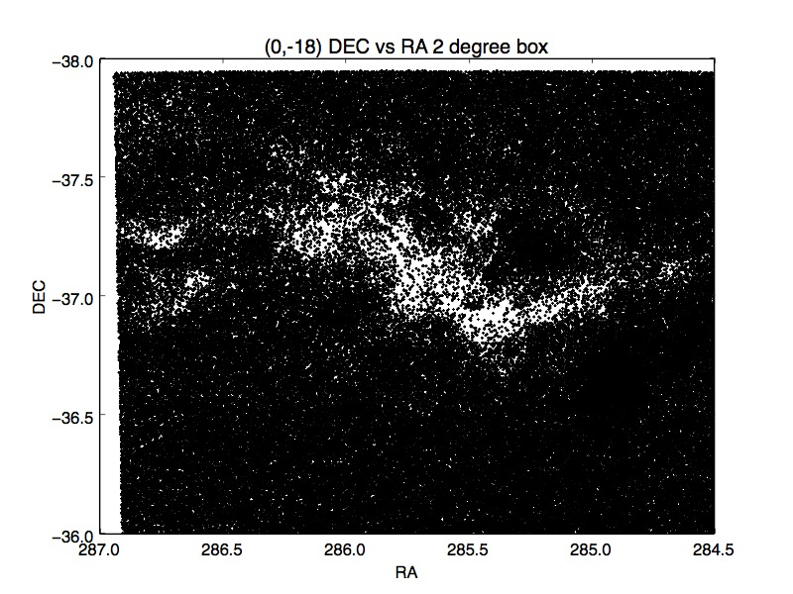
Quantifying Extinction
Notes:
Shown here is V Corona Australis plotted in equatorial coordinates, Right Ascension on the x axis and Declination on the y axis. This is because in studying a dense area of the cloud in the optical, it only detects the stars that are poking through holes in the dense cloud and views it as an area with low extinction when that is not the case, which is an optical bias that NICEST accounts for.

Slide 12
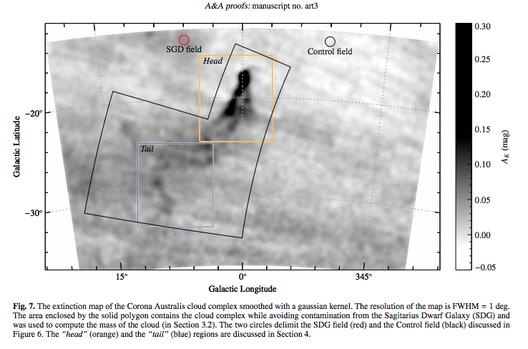
Extinction Mapping
Routine for quantifying extinction
Implement NICER
Look at UCAC4
Implement NICEST
Extinction maps with a large dynamic range
Alves et al.
J. Alves, M. Lombardi and C. Lada. “2MASS wide-field extinction maps: V. Corona Australis”. A&A. July 2001.
Notes:
Thus far I have created a routine to quantify extinction. After creating a gridding routine and creating some extinction maps, I will be able to implement NICER further. I will then look at the catalogue of UCAC4 since it has better photometry than NOMAD. Eventually, I will implement NICEST in order to correct the optical bias in the dense regions of a cloud. Joining all of this together will help me to create an extinction map with a large dynamic range that is sensitive with both high and low extinction.

Slide 13


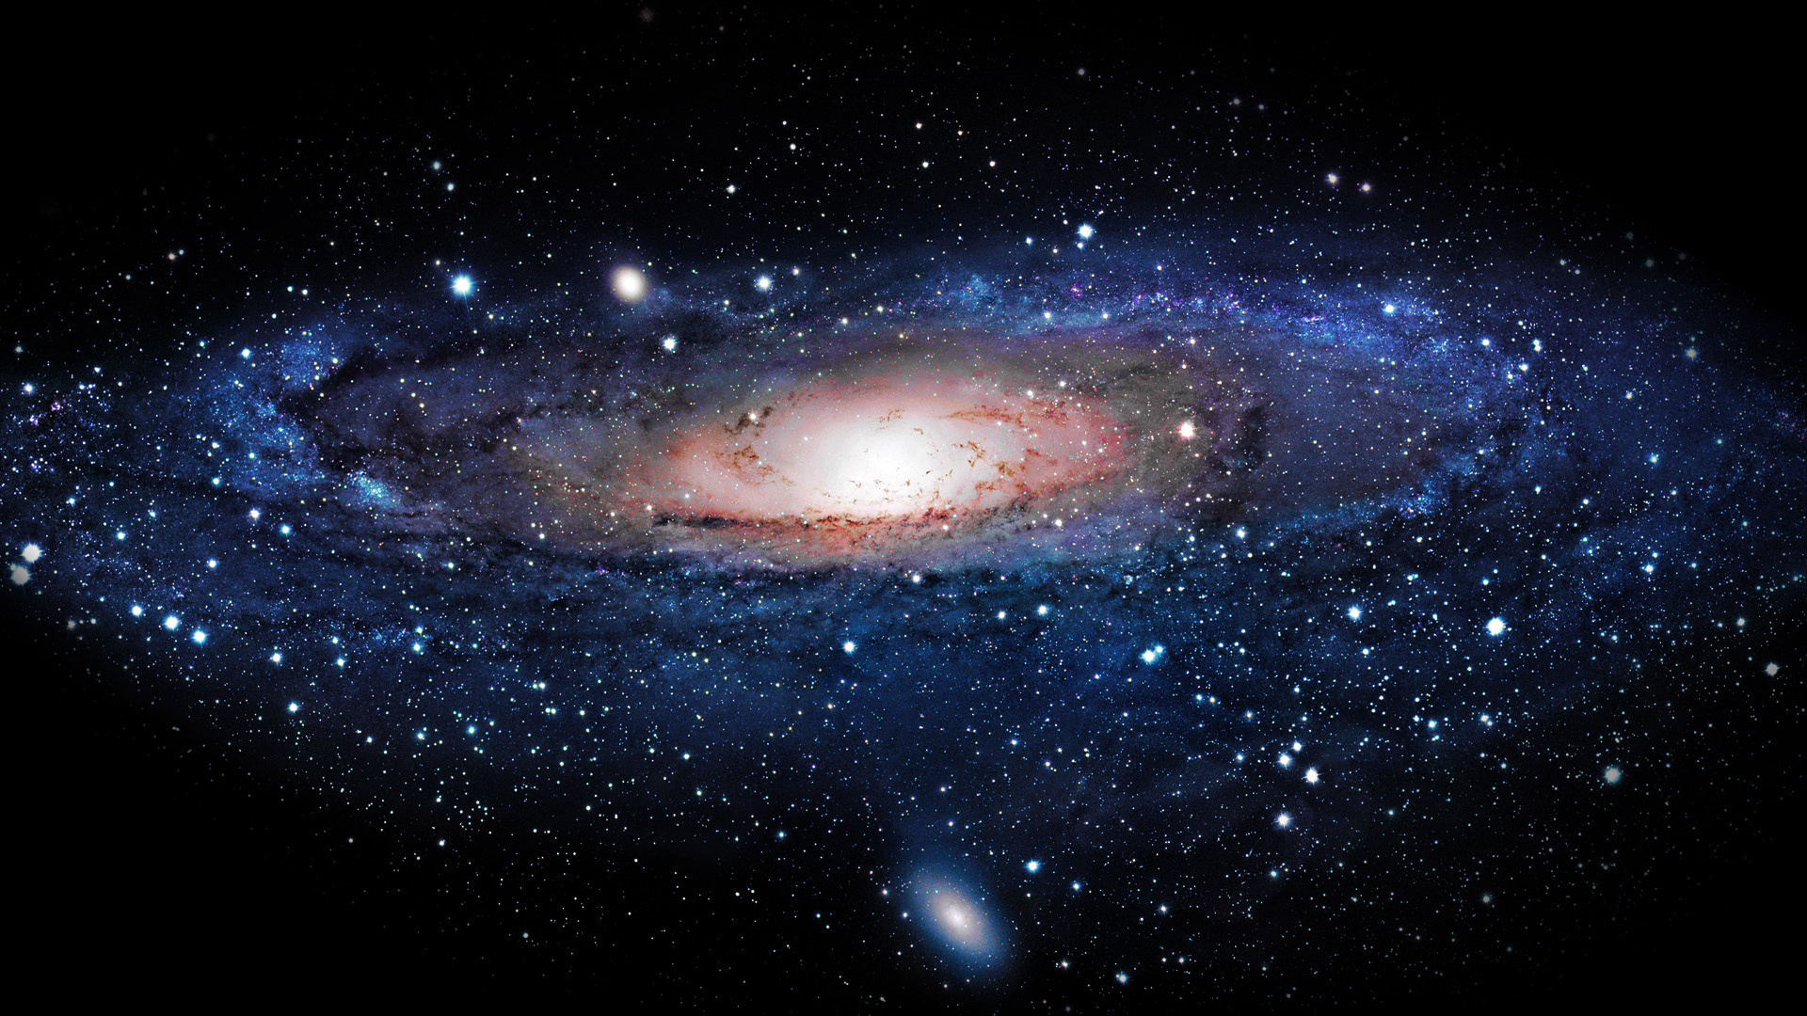


Special Thanks to… Research Advisor: Tim Paglione AstroCom NYC LSAMP The Universe Questions?

Slide 14
Sources
http://en.wikipedia.org/wiki/Extinction_(astronomy)
Lombardi, M. and Alves, J. “Mapping the interstellar dust with near-infrared observations: An optimized multi-band technique”. Astronomy & Astrophysics. July 2001.
http://www.usno.navy.mil/USNO/astrometry/optical-IR-prod/nomad
Rieke, G.H. and Lebofsky, M.J. “The Interstellar Extinction Law from 1 to 13 Microns”. The Astrophysical Journal. Jan 1985.
Alves, J. et al. “2MASS wide-field extinction maps: V. Corona Australis”. Astronomy & Astrophysics. Jan 2014.

